Slide 1
Lesson 3
Begin With The End in Mind:
Operation Desert Storm

Slide 2
Lesson Objectives
• Understand how the military conduct of the Gulf War supported the strategic objectives of the conflict. • Be able to discuss the impact of technology and logistics on modern war. • Establish recognizable end points for the major threads of modern war (weapons, logistics, communications, strategy, and operational art).

Slide 3
Timeline of Events
• Iraq invades Kuwait, Aug. 2, 1990
• Operation Desert Shield begins, Aug. 7
• First call-up of Selected Reservists to active duty for 90 days, by executive order, Aug. 22
• NSD 54, Responding to Iraqi Aggression in the Gulf, authorized the use of military force, Jan. 15
• Operation Desert Storm air war phase begins, 3 a.m., Jan. 17, 1991 (Jan. 16, 7 p.m. EST)

Slide 4
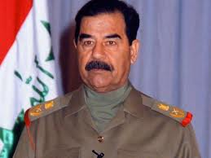
Saddam Hussein
1937 - 2006
The great duel, the mother of all battles has begun.… The dawn of victory nears as this great showdown begins!
January 17, 1991

Slide 5
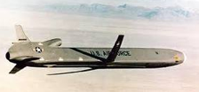
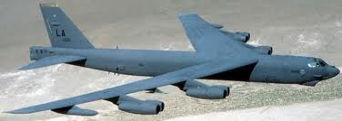
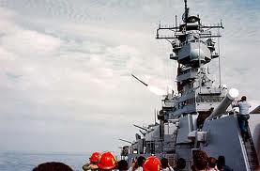
Who Fired the First Shot?
B-52 & ALCM?
(Air-Launched Cruise Missile)
USS Wisconsin & Tomahawk?

Slide 6
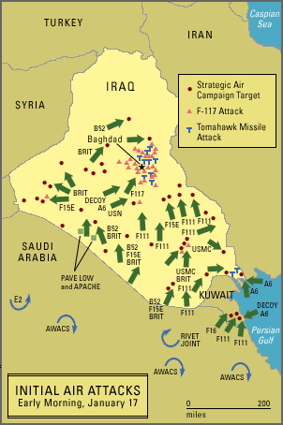
Air War Phase
Video

Slide 7
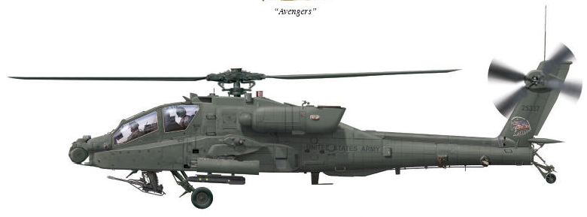
Who Had the First Impact?
U. S. Army
TF Normandy
• Combined Army – Air Force helicopter operation
• Destroy key Iraqi radar site
• Punch a hole in the Iraqi warning line
7
Notes:
7

Slide 8
Air War Phase

Slide 9
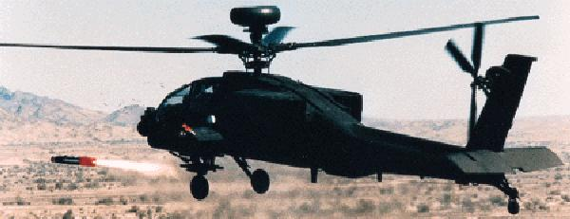
TF Normandy
AH-64 Apache helicopter and Hellfire missile

Slide 10
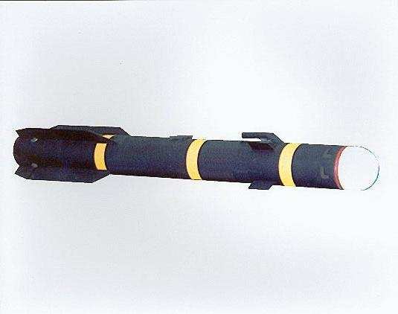
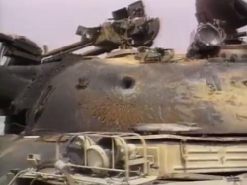
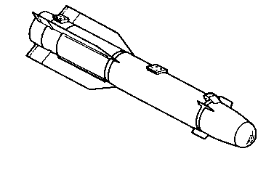
TF Normandy
Shaped Charge Warhead
Hellfire missile

Slide 11
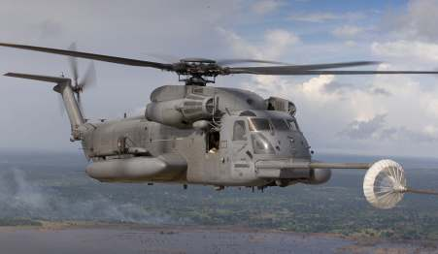
TF Normandy
MH-53 Pave Low III

Slide 12
Task Force Normandy
©
Online
(very large files – slow download)
(
"The Circle of Modern War" and logo
© Thomas D. Pilsch 2007-2013

Slide 13
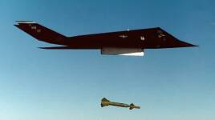
Precision Guided Munitions
(PGM)
F-117 Nighthawk

Slide 14
Precision Guided Munitions
Two Types Used:
Laser Guided
TV Guided
GBU-10 (Mk-84 2,000 lb. bomb)

Slide 15
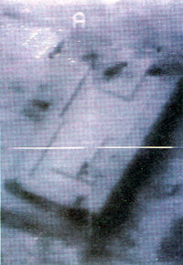
Precision Guided Munitions
TV Guided

Slide 16
TV Guided Bomb
(Not available online)
(
"The Circle of Modern War" and logo
© Thomas D. Pilsch 2007-2013

Slide 17
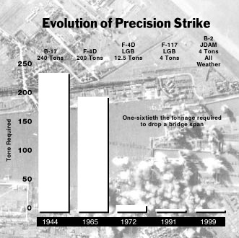
Precision Guided Munitions
Tons of Bombs to Drop a Bridge Span
Air Force magazine, July 2001

Slide 18
Precision Guided Munitions
Only 8.4% of the 88,500 tons of bombs were PGM
Air Power Australia, Aug/Sep 1992

Slide 19
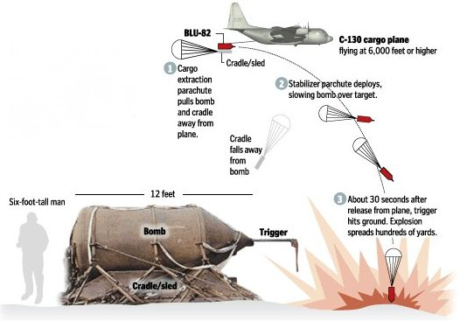
Big Dumb Bombs
BLU-82 “Daisy Cutter” 15,000 LB (6,800 KG)
http://www.bellum.nu/armoury/BLU82B.html

Slide 20
Timeline of Events
• Iraq invades Kuwait, Aug. 2, 1990
• Operation Desert Shield begins, Aug. 7
• First call-up of Selected Reservists to active duty for 90 days, by executive order, Aug. 22
• Operation Desert Storm and air war phase begins,
3 a.m., Jan. 17, 1991 (Jan. 16, 7 p.m. EST)
• Iraq attacks Israel with seven Scud missiles, Jan. 17

Slide 21
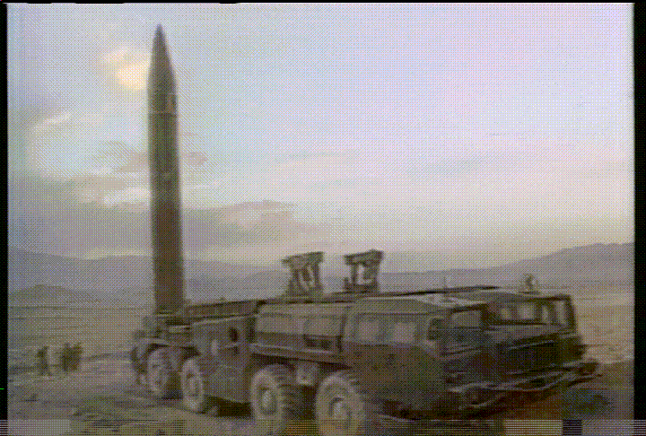
Scud Missile

Slide 22
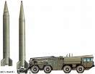
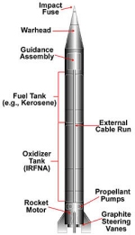
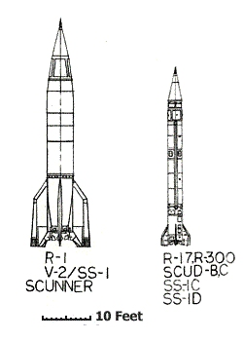
Scud Missile
Scud & TEL
Length: 11.25 m
Range: ~ 600 km
CEP: 900 m

Slide 23
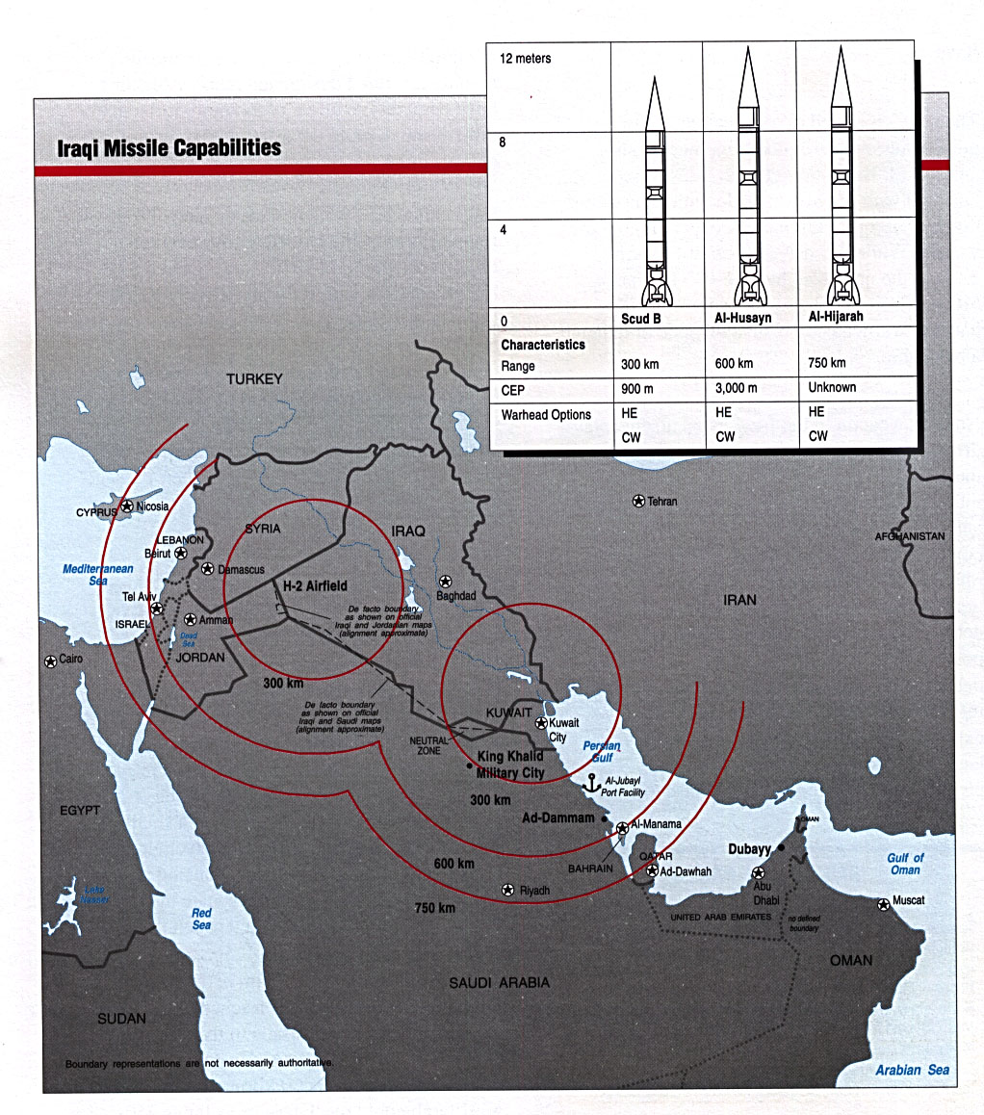
Scud Missile

Slide 24
Saddam’s Scud Strategy
Hypothetical
• Iraq launched Scud missiles at Israel to provoke a response
, hoping …
• An Israeli attack on Iraq would galvanize Arab coalition members to withdraw
US response:
• Deployed Patriot missiles from Europe to Israel
• Major diversion of air assets to “Scud hunting”

Slide 25
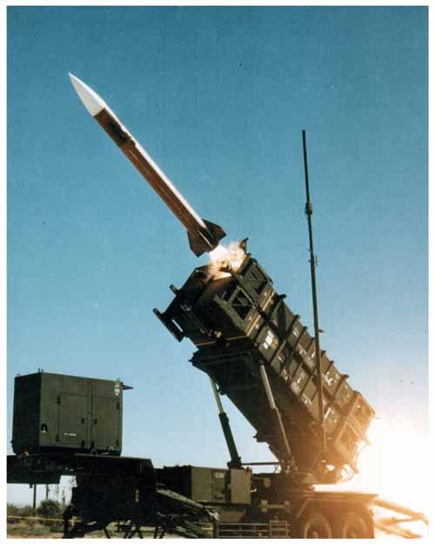
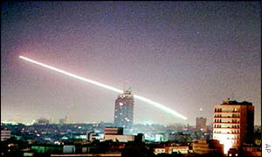
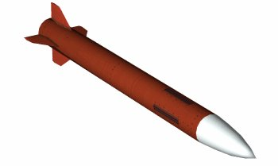
Patriot Missile

Slide 26
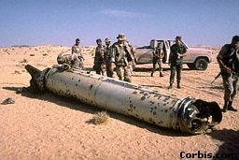
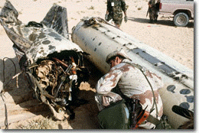
Patriot vs. Scud
How effective?
Scuds fired: 40 at Israel 46 at Saudi Arabia
Direct Casualties:
Israel: 1 Saudi Arabia: 1 civilian, 28 US soldiers

Slide 27
Patriot vs. Scud
How effective?
We found no convincing evidence in the video that any Scud warhead was destroyed by a Patriot. We have strong evidence that Patriots hit Scuds on two occasions, but in both cases the videos also show that the Scud warheads fell to the ground and exploded. These clips provide strong evidence that even when Patriots could hit Scuds they were still not able to destroy Scud warheads.
show that the Scud warheads fell to the ground and exploded. These clips provide strong evidence that even when Patriots could hit Scuds they were still not able to destroy Scud warheads.
Theodore A. Postol
Professor of Science,Technology,and National Security Policy
Massachusetts Institute of Technology
Letter to the House Armed services Committee September 8, 1992
INSIDE THE ARMY - October 5, 1992 •
Notes:
Click to next slide for EMPHASIS

Slide 28
Significance of Scud Campaign
• Diverted air assets from attacking Iraqi army
• Demonstrated effectiveness of a relatively cheap weapon to counter high-tech forces
• Demonstrated difficulty of destroying relocatable targets

Slide 29
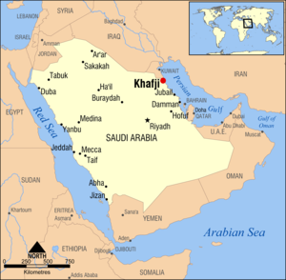
Battle of Khafji
January 29 - February 1, 1991
Iraqi forces invaded Saudi Arabia
• Likely testing coalition strength
Coalition taken by surprise
Khafji captured by Iraqis
USMC recon teams trapped
• directed fire during counterattack
Khafji retaken by coalition forces (USMC, Saudi Arabia and Qatar) in intense, close-quarter fighting
Significance: Showed Iraqi forces not as vaunted as feared
Video (6:29 - optional)

Slide 30
Timeline of Events
President Bush authorizes the call-up of up to 1 million National Guardsmen and Reservist for up to two years, Jan. 18.
DoD announces deployment of Europe-based Patriot missiles and crews to Israel, Jan. 19.
First successful intercept of Scud by Patriot missile claimed over Dhahran, Saudi Arabia, Jan. 17.
Iraq creates massive oil slick in gulf, Jan. 25.
• Iraqis ignite estimate 700 oil wells in Kuwait, Feb. 23.

Slide 31
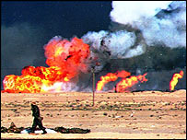
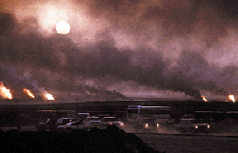
Oil Well Fires
Iraqis ignite estimated 700 oil wells in Kuwait, Feb. 23.

Slide 32
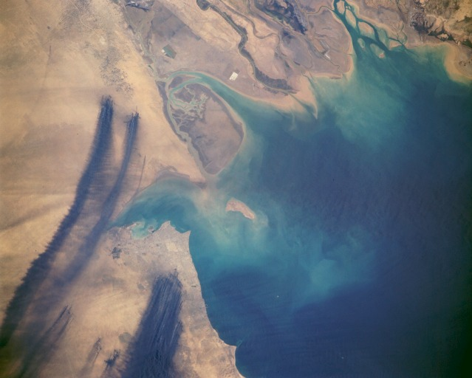
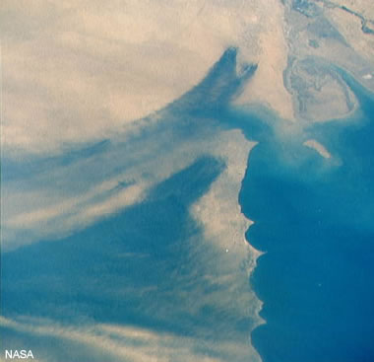
Oil Well Fires
Iraqis ignite estimated 700 oil wells in Kuwait, Feb. 23.

Slide 33
Timeline of Events
President Bush authorizes the call-up of up to 1 million National Guardsmen and Reservist for up to two years, Jan. 18.
DoD announces deployment of Europe-based Patriot missiles and crews to Israel, Jan. 19.
Patriot missile first successful intercept of Scud claimed over Dhahran, Saudi Arabia, Jan. 17.
Iraq creates massive oil slick in gulf, Jan. 25.
Iraqis ignite estimate 700 oil wells in Kuwait, Feb. 23.
Allied ground assault begins, 4 a.m., Feb 24
(Feb. 23, 8 p.m. Eastern time).

Slide 34
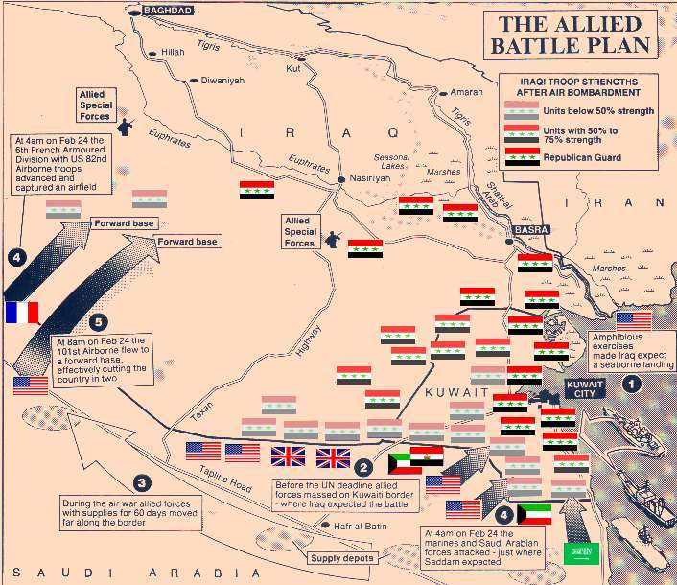

Slide 35
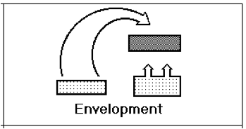
Classic Envelopment

Slide 36
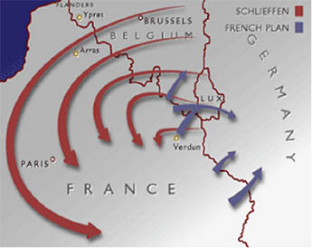
Classic Envelopment
(almost)
Schlieffen Plan (1905, 1914)

Slide 37
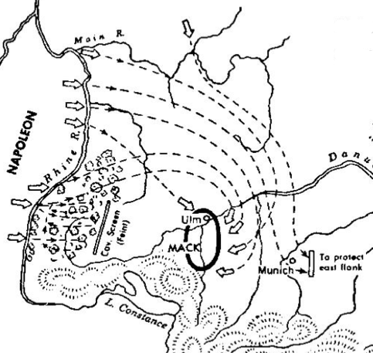
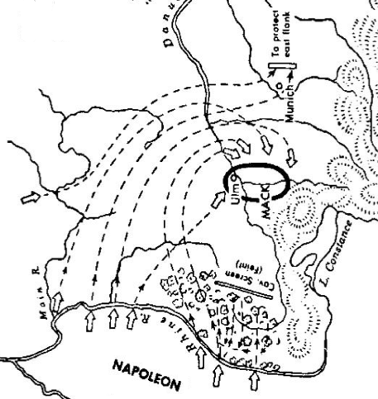
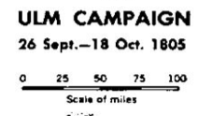
Classic Envelopment
Napoleonic Wars

Slide 38
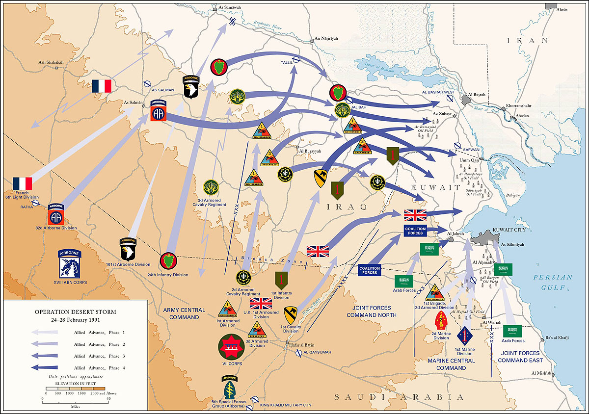
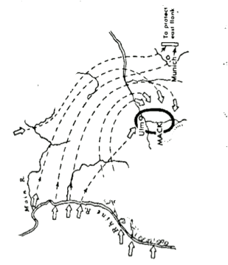
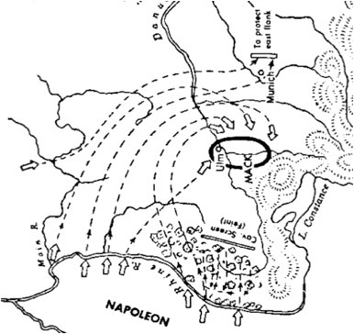

Slide 39
Guest Speaker

Slide 40
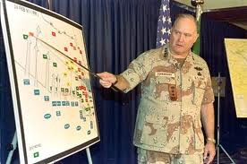
General Norman Schwarzkopf
Briefing on the Conduct of the Gulf War
Riyadh, Saudi Arabia
February 27, 1991

Slide 41
Gen. Schwarzkopf Briefing
YouTube Video (57:44)
"The Circle of Modern War" and logo
© Thomas D. Pilsch 2007-2013

Slide 42
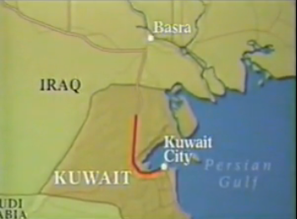
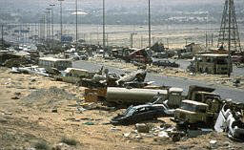
Highway From Kuwait

Slide 43
Highway From Kuwait
©
YouTube Video (3:51)
"The Circle of Modern War" and logo
© Thomas D. Pilsch 2007-2013

Slide 44
Timeline of Events
Iraqi Scud destroys U.S. barracks in Dhahran, killing 28 U.S. soldiers, Feb. 25.
Cessation of hostilities declared, 8:01 a.m., Feb. 28 (12:01 a.m. Eastern).
Cease-fire terms negotiated in Safwan, Iraq, March 1.
DoD announces first troop redeployment home, March l7 (24th Infantry Division, Fort Stewart, Ga.)

Slide 45
Timeline of Events
Iraqi Scud destroys U.S. barracks in Dhahran, killing 28 U.S. soldiers, Feb. 25.
Cessation of hostilities declared, 8:01 a.m., Feb. 28 (12:01 a.m. Eastern).
Cease-fire terms negotiated in Safwan, Iraq, March 1.
DoD announces first troop redeployment home, March l7 (24th Infantry Division, Fort Stewart, Ga.)

Slide 46
Review
Timeline of the War
• Operation Desert Storm air war phase begins,
3 a.m., Jan. 17, 1991 (Jan. 16, 7 p.m. Eastern time)
Allied ground assault begins, 4 a.m., Feb 24
(Feb. 23, 8 p.m. Eastern time).
Cessation of hostilities declared, 8:01 a.m., Feb. 28
(12:01 a.m. Eastern).
Initial Air Phase: 38 days
Ground Phase: 100 hours

Slide 47
Statistics of the War
Coalition of 34 nations (27 sent forces)
Afghanistan, Argentina, Australia, Bahrain, Bangladesh, Canada, Czechoslovakia, Denmark, Egypt, France, Germany, Greece, Hungary, Honduras, Italy, Kuwait, Morocco, The Netherlands, Niger, Norway, Oman, Pakistan, Poland, Portugal, Qatar, Saudi Arabia, Senegal, South Korea, Spain, Syria, Turkey, The United Arab Emirates, the United Kingdom and the United States.
609,000 troops (540,000 U.S.)
Coalition Casualties
U.S. - 148 combat dead, 145 noncombat
Britain - 24 (9 by US fire)
France - 2
Allied Arab forces - 39
Source: CNN

Slide 48
Fratricide
“Friendly fire isn’t”
Murphy’s Laws of War •

Slide 49
Fratricide
Of 148 U.S. combat deaths
35 were caused by “friendly” fire
24% of deaths due to fratricide
Associated Press
March 18, 2003
A

Slide 50
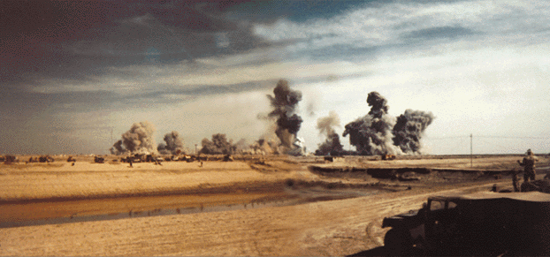
Gulf War Syndrome
Approximately 1% of Gulf War vets report symptoms of unknown cause
Possible Sources:
• Chemical weapon residue?
• Depleted uranium?

Slide 51
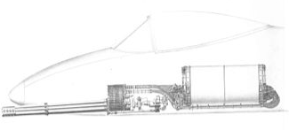
Gulf War Syndrome
Depleted uranium?
A-10 Thunderbolt II (a.k.a. The Warthog)
20 mm
30 mm DU
GAU-8 Avenger cannon

Slide 52
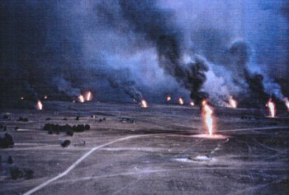
Gulf War Syndrome
Approximately 1% of Gulf War vets report symptoms of unknown cause
Possible Sources:
• Chemical weapon residue?
• Depleted uranium?
• Oil well fire residue?
• Other?

Slide 53
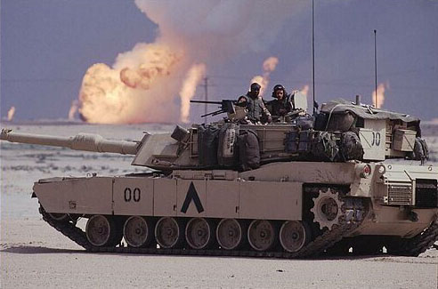
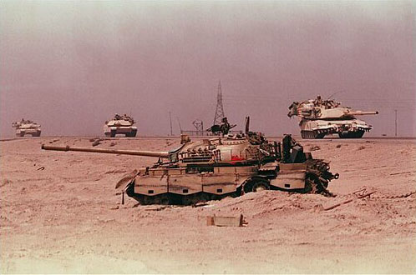
The 100 Hour War

Slide 54
The Perfect War?
Lessons Of Vietnam War Applied
The Weinberger Doctrine (1984)

Slide 55
Weinberger Doctrine
• … vital to our national interest or that of our allies . . . .
• … with the clear intention of winning . . . .
• … clearly defined political and military objectives . . . .
• … objectives … must be continually reassessed and adjusted . . . .
• … support of the American people . . .
• … last resort..
• The United States should not commit forces to combat overseas unless the particular engagement or occasion is deemed vital to our national interest or that of our allies . . . .
• If we decide it is necessary to put combat troops into a given situation, we should do so wholeheartedly and with the clear intention of winning . . . .
• If we do decide to commit forces to combat overseas, we should have clearly defined political and military objectives . . . .
• The relationship between our objectives and the forces we have committed -- their size, composition, and disposition -- must be continually reassessed and adjusted if necessary . . . .
• Before the United States commits combat forces abroad, there must be some reasonable assurance we will have the support of the American people and their elected representatives in Congress . . . .
• The commitment of US forces to combat should be a last resort.

Slide 56
The Perfect War?
Lessons of Vietnam War Applied
The 100 Hour War (?)
After a 38 Day Air Campaign!
Could/Should We Have Gone Further?

Slide 57
Controversy
Why did we not go on to Baghdad?

Slide 58
Why did we not go on to Baghdad?
While we hoped that popular revolt or coup would topple Saddam, neither the U.S. nor the countries of the region wished to see the breakup of the Iraqi state. We were concerned about the long-term balance of power at the head of the Gulf.
Trying to eliminate Saddam, extending the ground war into an occupation of Iraq, would have violated our guideline about not changing objectives in midstream, engaging in "mission creep," and would have incurred incalculable human and political costs.
George H. W. Bush and Brent Scowcroft
A World Transformed, 1998 (Chapter 19)

Slide 59
Why did we not go on to Baghdad?
Apprehending him was probably impossible. We had been unable to find Noriega in Panama, which we knew intimately.
We would have been forced to occupy Baghdad and, in effect, rule Iraq. The coalition would instantly have collapsed, the Arabs deserting it in anger and other allies pulling out as well. Under the circumstances, there was no viable "exit strategy" we could see, violating another of our principles.
George H. W. Bush and Brent Scowcroft
A World Transformed 1998 (Chapter 19)

Slide 60
Why did we not go on to Baghdad?
Furthermore, we had been self-consciously trying to set a pattern for handling aggression in the post-Cold War world. Going in and occupying Iraq, thus unilaterally exceeding the United Nations' mandate, would have destroyed the precedent of international response to aggression that we hoped to establish.
Had we gone the invasion route, the United States could conceivably still be an occupying power in a bitterly hostile land. It would have been a dramatically different -- perhaps barren -- outcome
George H. W. Bush and Brent Scowcroft
A World Transformed 1998 (Chapter 19)

Slide 61
Saddam’s Mistakes
What mistakes did Saddam Hussein make in the Gulf War?

Slide 62
Lessons
What lessons did the U.S. record from the Gulf War?

Slide 63
Persian Gulf War
Lessons Learned
• International coalitions essential
• Support of American people vital
• Clear division of leadership responsibilities
• “Jointness” (interservice cooperation) key
• All-volunteer force works
• Total Force (active, reserve mix) important
• Needs continuous attention

Slide 64
Persian Gulf War
Lessons Learned
• Technology works, particularly weapons, C³
• Airpower critical element of success
• Ability to react quickly to attacks is critical
• Sufficient mobility assets needed
• Expectations of low casualties may not be realistic
• Maritime mine warfare still a major weakness
• Ability to find, kill relocatable targets is weak

Slide 65
Final Comments on Gulf War

Slide 66
Thesis
The Gulf War (Operation Desert Storm) was the only war in U. S. history where we successfully implemented the lessons of the previous war from the beginning.
Notes:
66

Slide 67
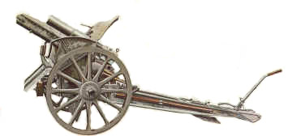
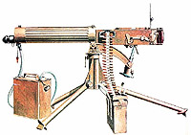
Lesson 4
The Emergence of Total War

Slide 68
Lesson Objectives
• Build a foundation for understanding the wars of the
20th century.
• Be able to define total war and describe its roots in the 19th century.
• Be able to describe how weapon technology changed the character of war at the beginning of the 20th century.
• Begin to understand the importance of logistics in modern war.

Slide 69
End

